Slide 1


SWATHI SUPPLY CHAIN SERVICES PVT LTD
LIVE THE EXPERIENCE, FEEL THE EXPERIENCE
(FORMERLY KNOWN AS SWATHI TRANSPORTS)

Slide 2
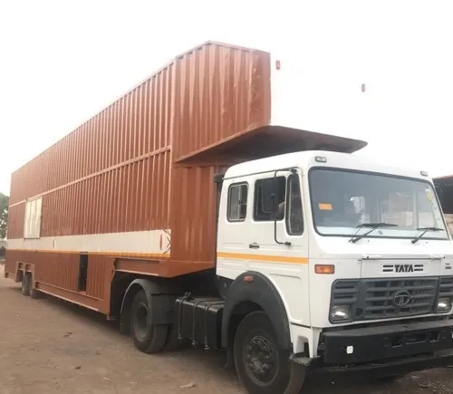
ABOUT US
Swathi Supply Chain Services has been one of the emerging auto logistics service provider based at Chennai city, an automobile hub of India. It has ventured into auto logistics industry in 2009 with a humble start of two trucks serving In-bound logistics solutions to Hyundai Motors India, Chennai. Having its utmost focus on customer delight, the company was given the out-bound logistics business viz finished cars chassis transportation to PAN India while serving inbound logistics from two trucks to fifteen trucks in 2013 with a considerable hike in the share of business during the course of business
COMPANY PROFILE
We have immense pleasure to introduce ourselves as one among the leading transport contractors in India, having registered office at Chennai. At present we have are having 400 of our own fleet and 100+ of the attached fleet. Our mission is to meet the client needs and deliver the best of our solutions. Nevertheless, our goal is to be a leading supplier in India who looks for global footprints.. We've built our reputation on excellence in transports, with a constant focus on serving our customers.

Slide 3
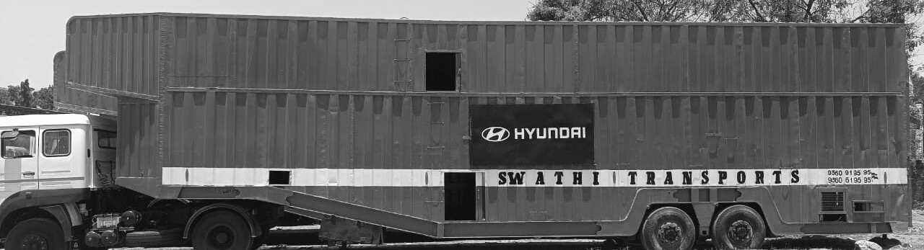
MISSION
VISION
To stay ahead among our rivals in the transport industry by providing world-class and innovative moving solutions to our clients. We wish to become the top choice of our customers when they are looking for a reliable, affordable and professional transporter.
Stay responsive to consumers’ requirement, find innovative and flexible solutions and strive to achieve customer satisfaction with our performance, honesty, and integrity. We aim to achieve our esteemed patrons’ trust and develop a lasting relationship with them

Slide 4

CORE VALUES
PASSION
CUSTOMER FOCUS
INNOVATION
POSITIVITE APPROACH
COLLOBORATION
OUR MANTRA
Our business was created to help a businesslike yours get dependable, excellentshipping from the loading dock to the customersite. When trust usto ship yourfreight, you'll know that the safe transport of your goodsisin the hands ofskilled, qualified professionals. Being the top providers of transportation servicesin India, we believe in maintaining transparency with a modern track & trace system, which helps clientsto know the currentstatus of their consignment. For handling perishable and sensitive goods, we use a large fleet of containerized trucks.

Slide 5

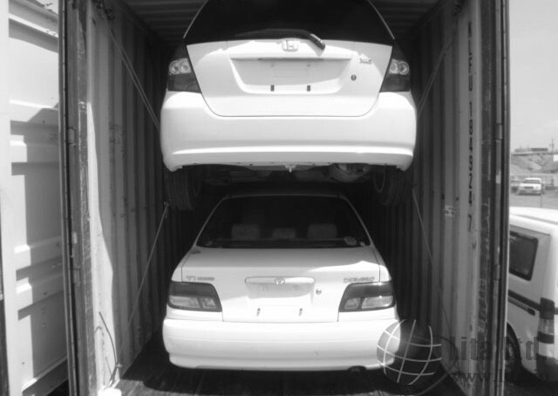

OUR SERVICES
Vehicle Transportation
SSCS offers a comprehensive suite of services in vehicle transportation. Our expertise in transportation industry ensures the safe and efficient delivery od vehicles to their destination in various segments like cars and tractors.
AUTO PARTS
Support for the production process, from individual parts to car frames. Services such as milk runs (cyclic collection by truck), round trip transportation, and . Respond to needs for transporting automobiles and provide full support to transport and delivery.
WAREHOUSING
Providing warehousing servicesis a major part of any company engaged in the transportation of vehicles. Warehouse is a storage structure constructed forthe protection of the quality and quantity of the stored produce. Warehouses enablesthe businessmen to carry on production throughout the year and sell their products, wheneverthere is adequate demand.

Slide 6







OUR PRINCIPLES
Ethical Business
Decision Making
Respect human rights
Risk management
Health & safety
Green Energy

Slide 7





WHY CHOOSE US?
We fully appreciate the value of customer’s money – unbeaten on the cost-effectiveness
A qualified and skilled professional who provide stress-free and satisfactory services
Speedy communication
& Reporting
Timely delivery of services
No compromise on Quality
Significant improvement in the productivity of your business
A competent workforce

Slide 8














OUR CLIENTELE

Slide 9









OUR CLIENTELE

Slide 10
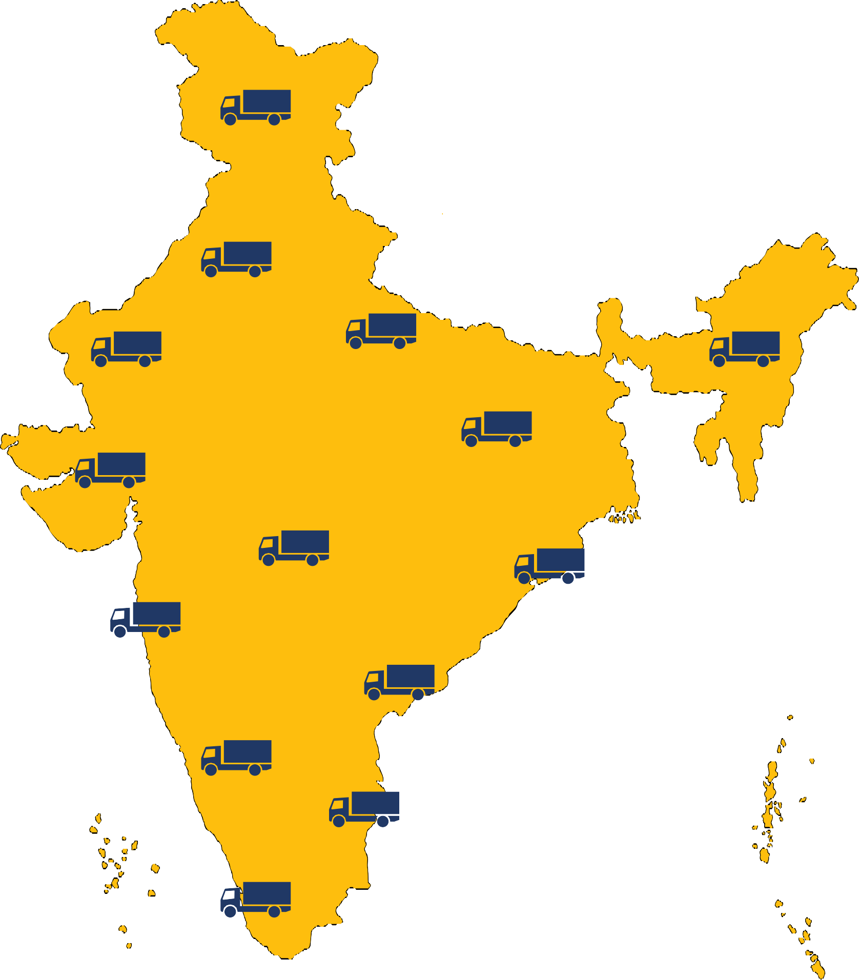
OUR
NETWORK
250 Trucks All Over India

Slide 11
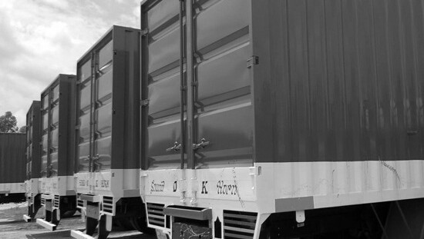

CONTACT US
www. swathisupplychainservices. com
+91 8806 862 191
+91 9843 317 335
+91 7989 852 536
+91 8610 170 599
N402, KG CENTER POINT,
Palanjuragraham,
Palanjur,
Chennai-600123.
swathisupplychainservices@ gmail. com

